Slide 1
Predicting Grant Review Outcomes at the National Institute of Mental Health
Jamie Doyle

Slide 2



Increased Focus on NIH Peer Review and Funding

Slide 3
Background
Funding decisions are based broadly on two factors:
Peer review
Institute priorities
Pre-application
Application sent
Peer review
(3 reviewers)
Discussion
Council
Primary reviewer/ reader
5 Criteria: Significance, Innovation, Approach, Investigator, Environment
1 through 9
Overall score
50% of applications are discussed
Overall application score
assigned
Decision

Slide 4
More on 5 Criteria
1. Significance . Does this study address an important problem?
2. Approach . Are the conceptual or clinical framework, design, methods, and analyses adequately developed, well integrated, well reasoned, and appropriate to the aims of the project?
3. Innovation . Is the project original and innovative?
4. Investigators . Are the investigators appropriately trained and well suited to carry out this work?
5. Environment . Does the scientific environment in which the work will be done contribute to the probability of success?
Source: http://grants.nih.gov/grants/guide/notice-files/NOT-OD-05-002.html

Slide 5
Research Question
Which criterion scores are predictive (and from what reviewer) of an application getting discussed or funded?
Are the predictors the same?
Useful for pre-applications phase and for potentially changing how we make funding decisions.

Slide 6
Data/Methods
Data: NIH administrative database of de novo R01 applications, 2010-2014
Methods:
Logistic regression
Classification tree
Conditional inference tree—PARTY!
Random forest

Slide 7
Conditional inference tree
Recall: Classification tree
Variables are selected to maximize the Gini index or node purity
Conditional inference tree:
Variables are selected by conducting permutation tests recursively (test null hypothesis of independence between any of the input variables and the response→ select the input variable with strongest association to the response. Repeat).

Slide 8
Descriptives
Variable | Percent/Mean (N /Std)
Discussed | 56% (n=3521)
Funded | 19% (n=1180)
Significance | 3.02 (1.1)
Approach | 4.2 (1.4)
Investigator | 2.1 (0.9)
Innovation | 3.0 (1.0)
FY
2010 | 21% (n=1284)
2011 | 20% (n=1270)
2012 | 21% (n=1326)
2013 | 19% (n=1197)
2014 | 19% (n=1168)
Early Stage Investigator | 18% (n=1138)

Slide 9
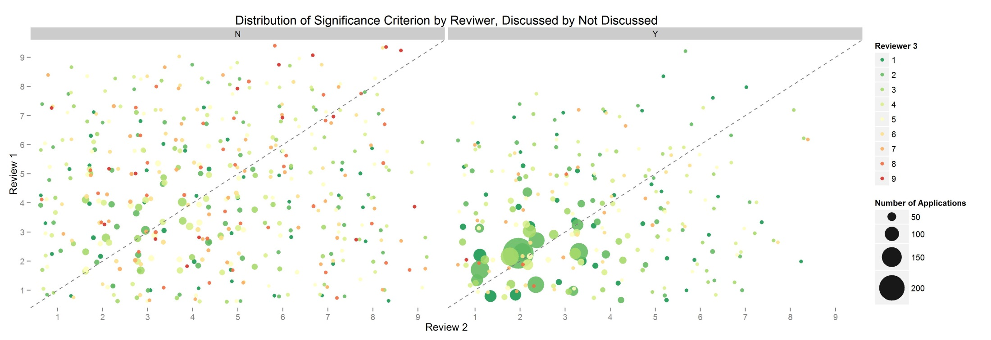
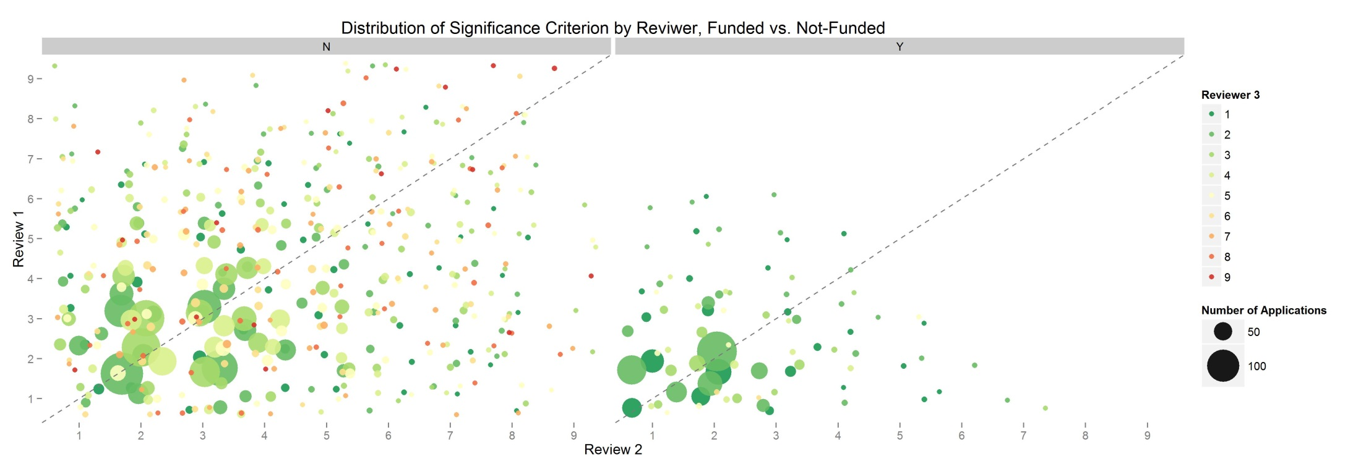

Slide 10
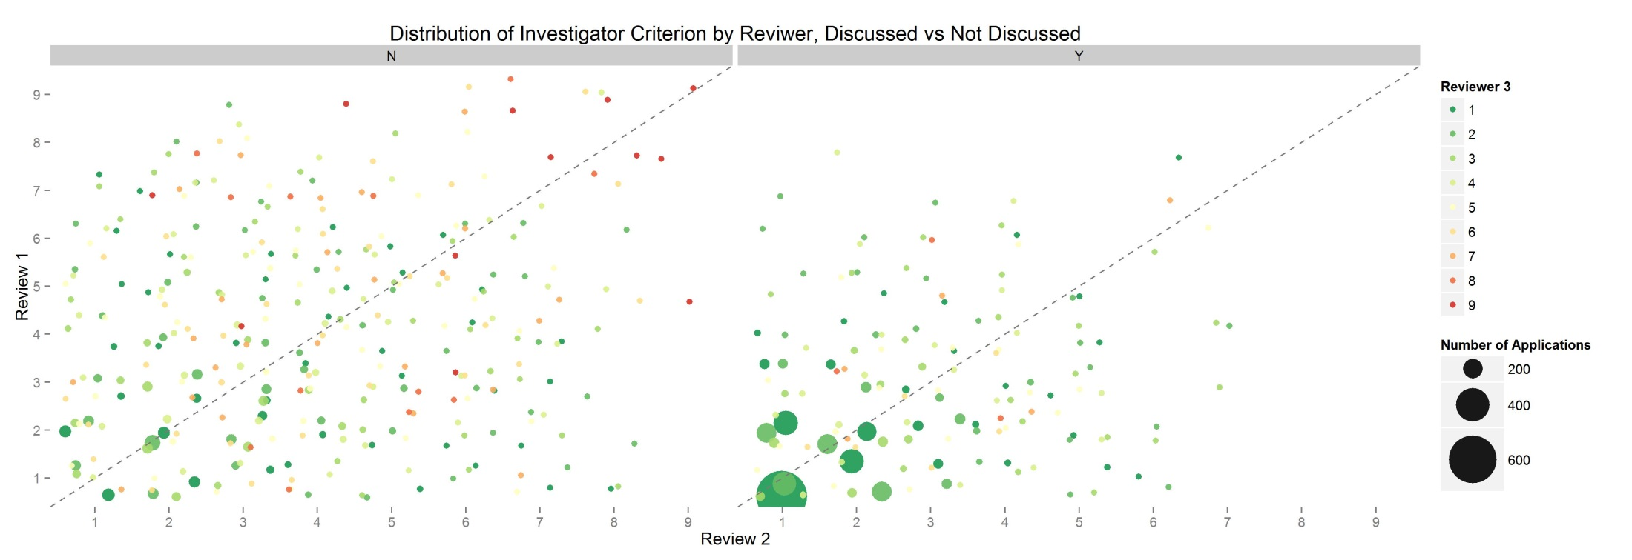
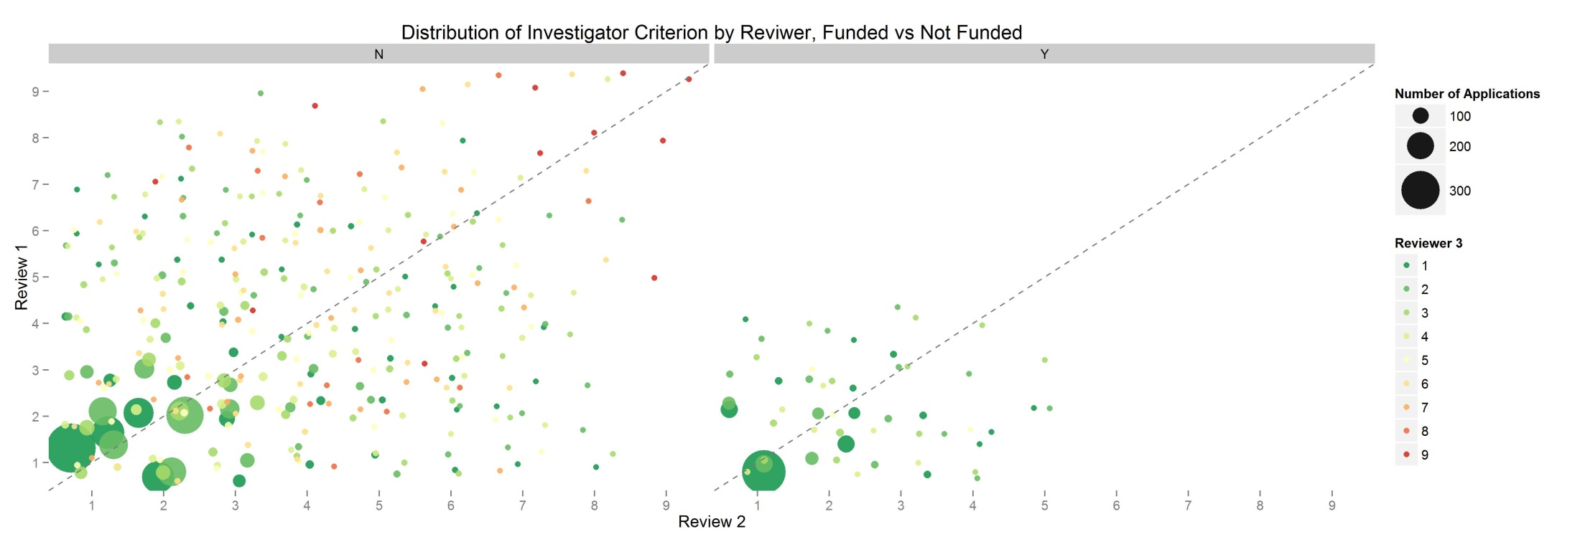

Slide 11
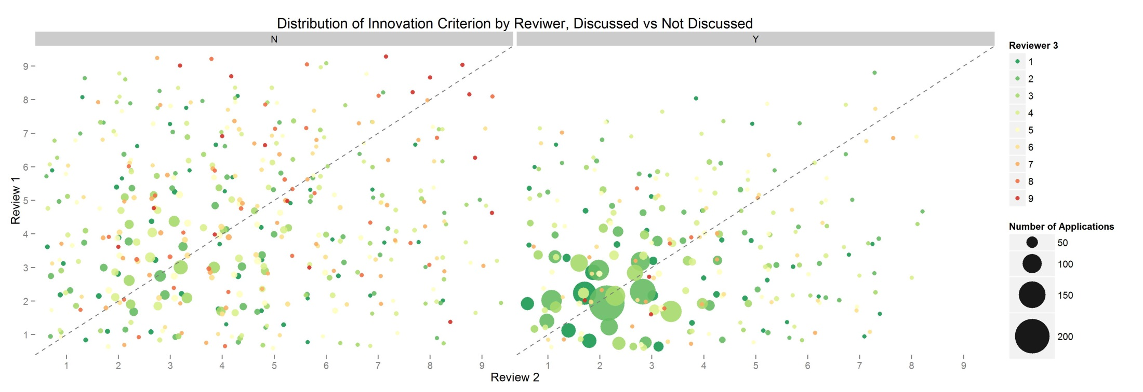
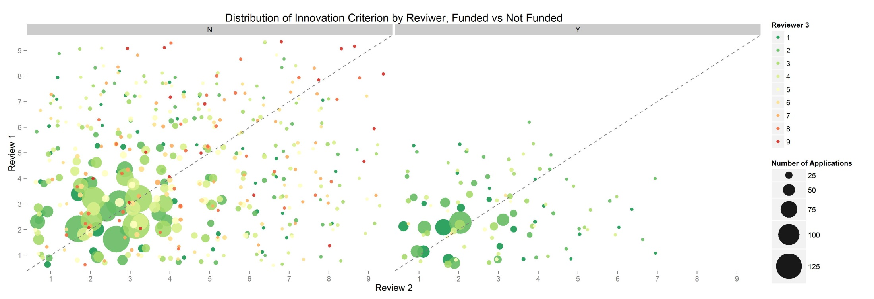

Slide 12
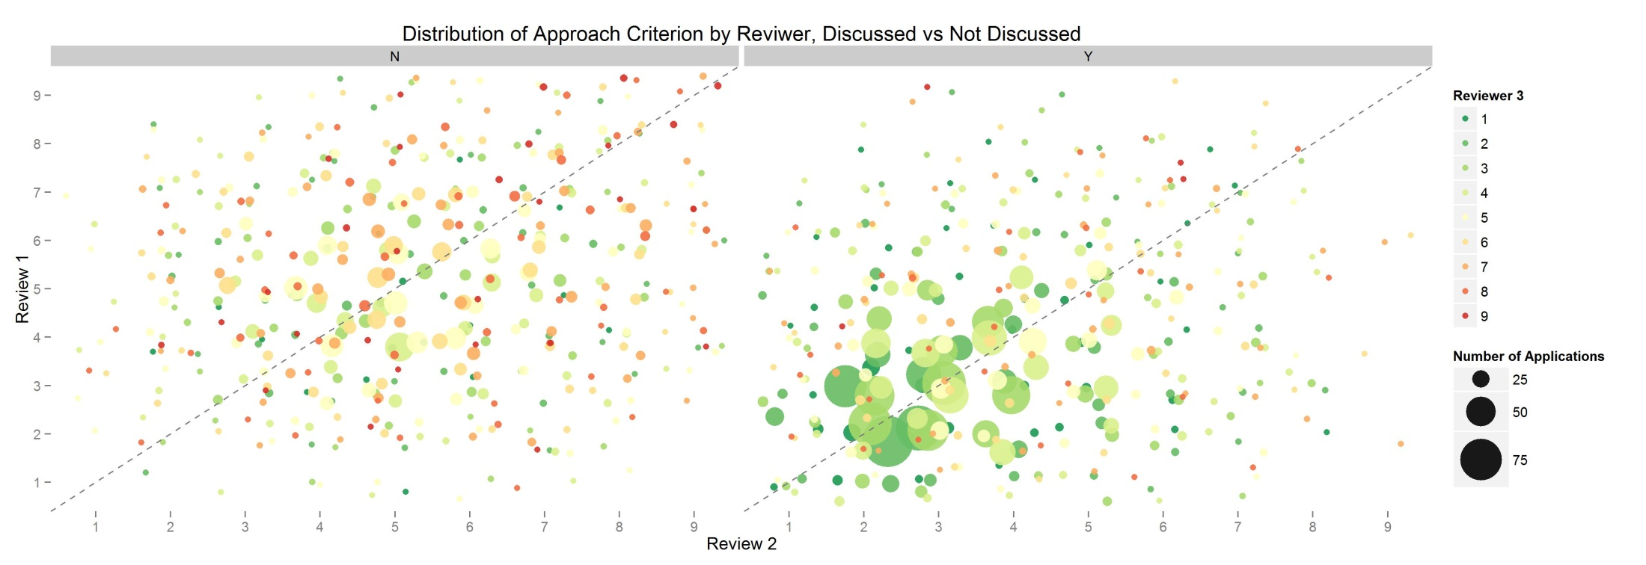
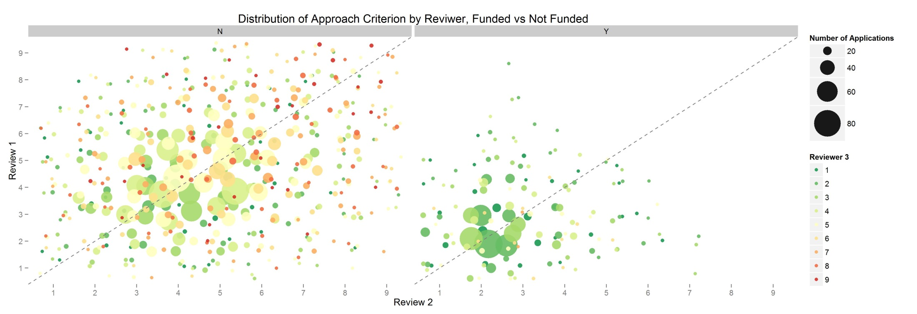

Slide 13
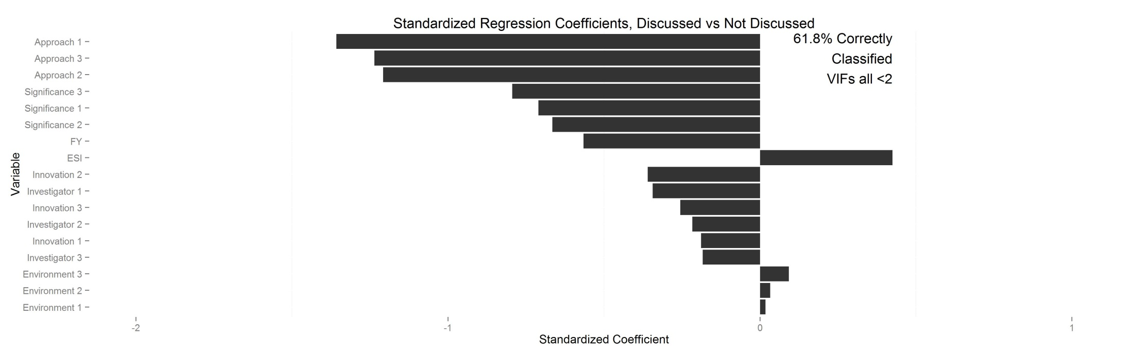
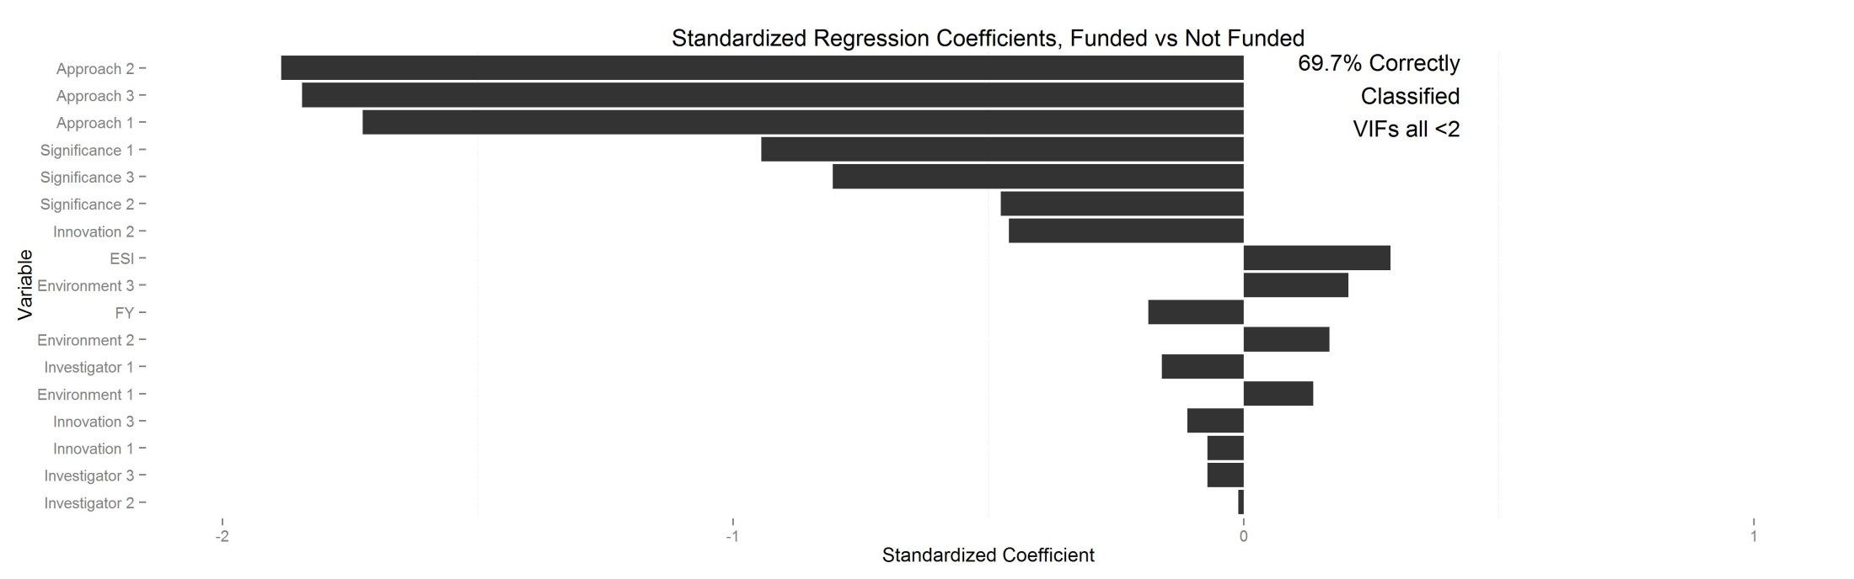
Logistic Regression

Slide 14
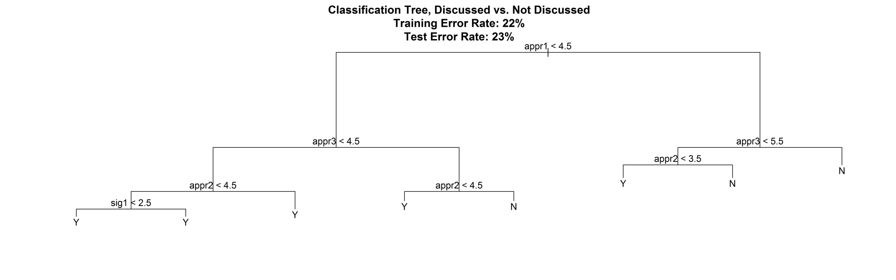
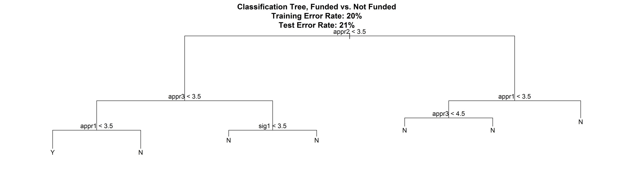
Classification Tree
77% Correctly Classified
79% Correctly Classified

Slide 15
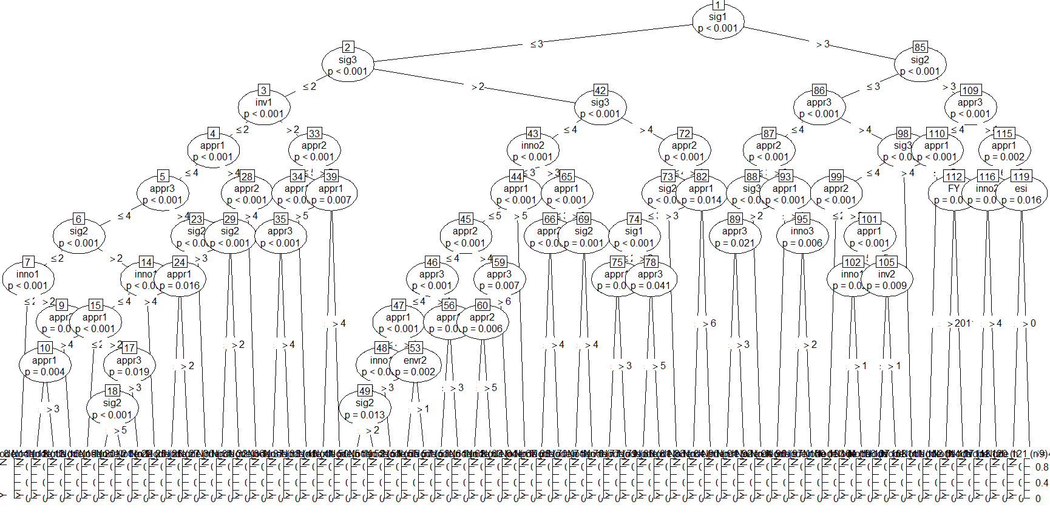
Conditional Inference Trees, Discussed (Big ugly illegible tree)
80% Correctly Classified

Slide 16

Conditional Inference Trees, Discussed (Big ugly illegible tree)

Slide 17
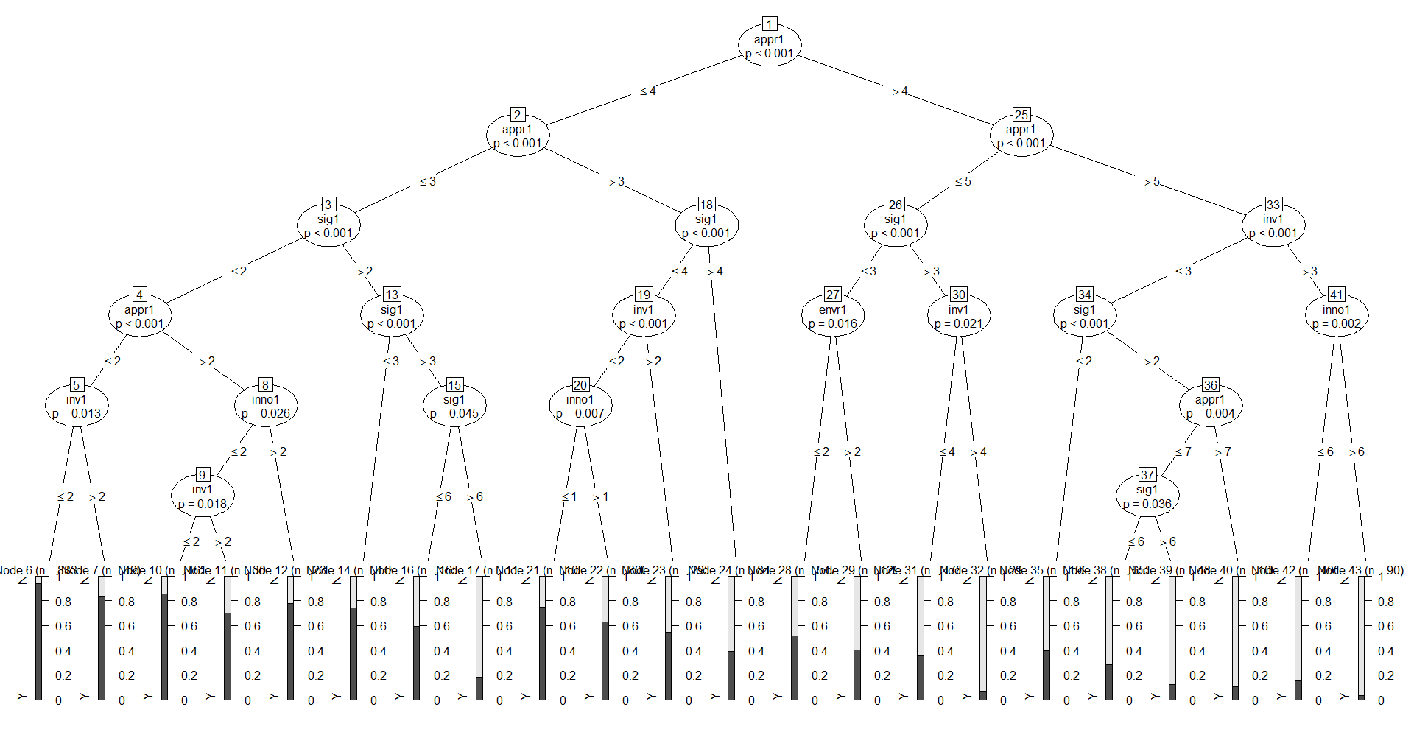
Conditional Inference Tree (Abridged), Discussed
73% Correctly Classified

Slide 18
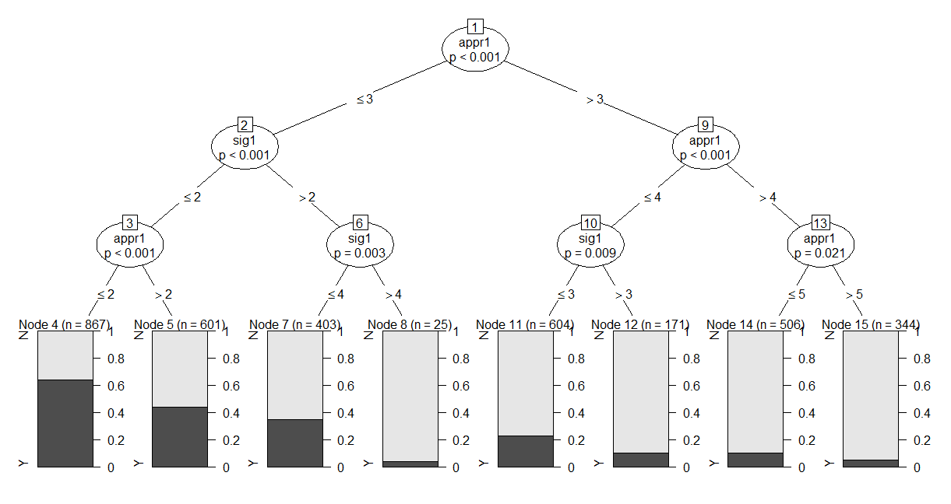
Conditional Inference Tree (Abridged), Funded
73% Correctly Classified

Slide 19
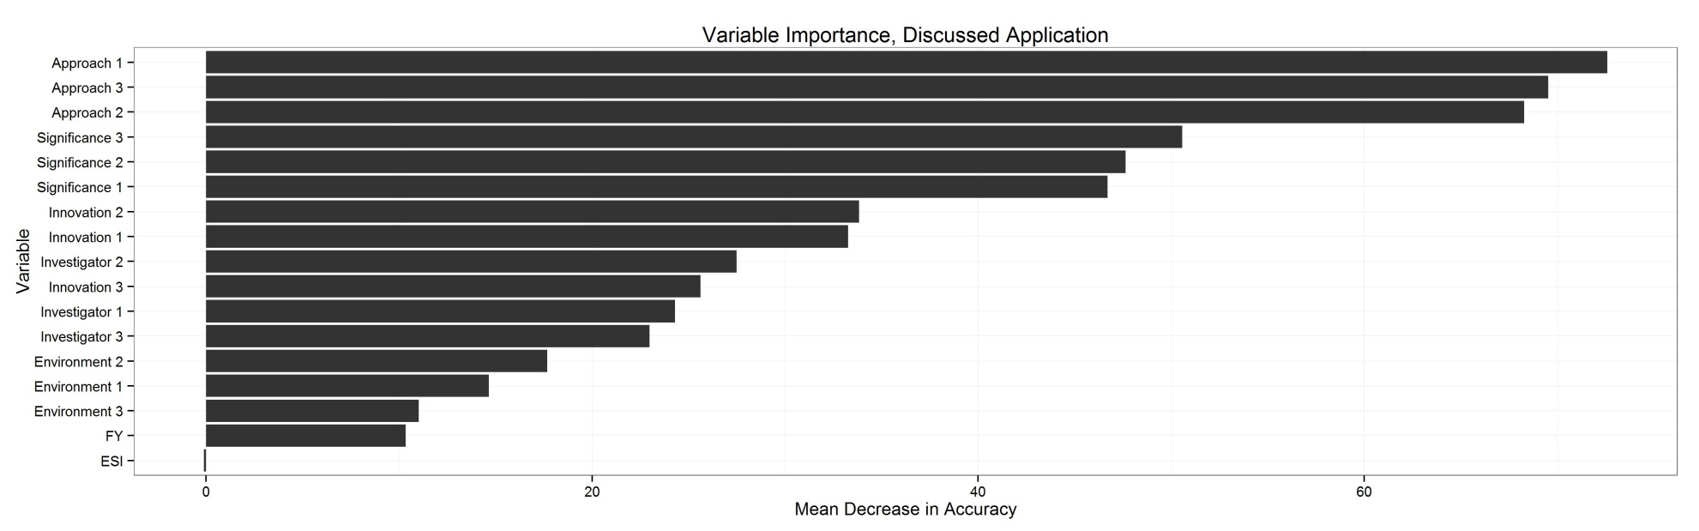
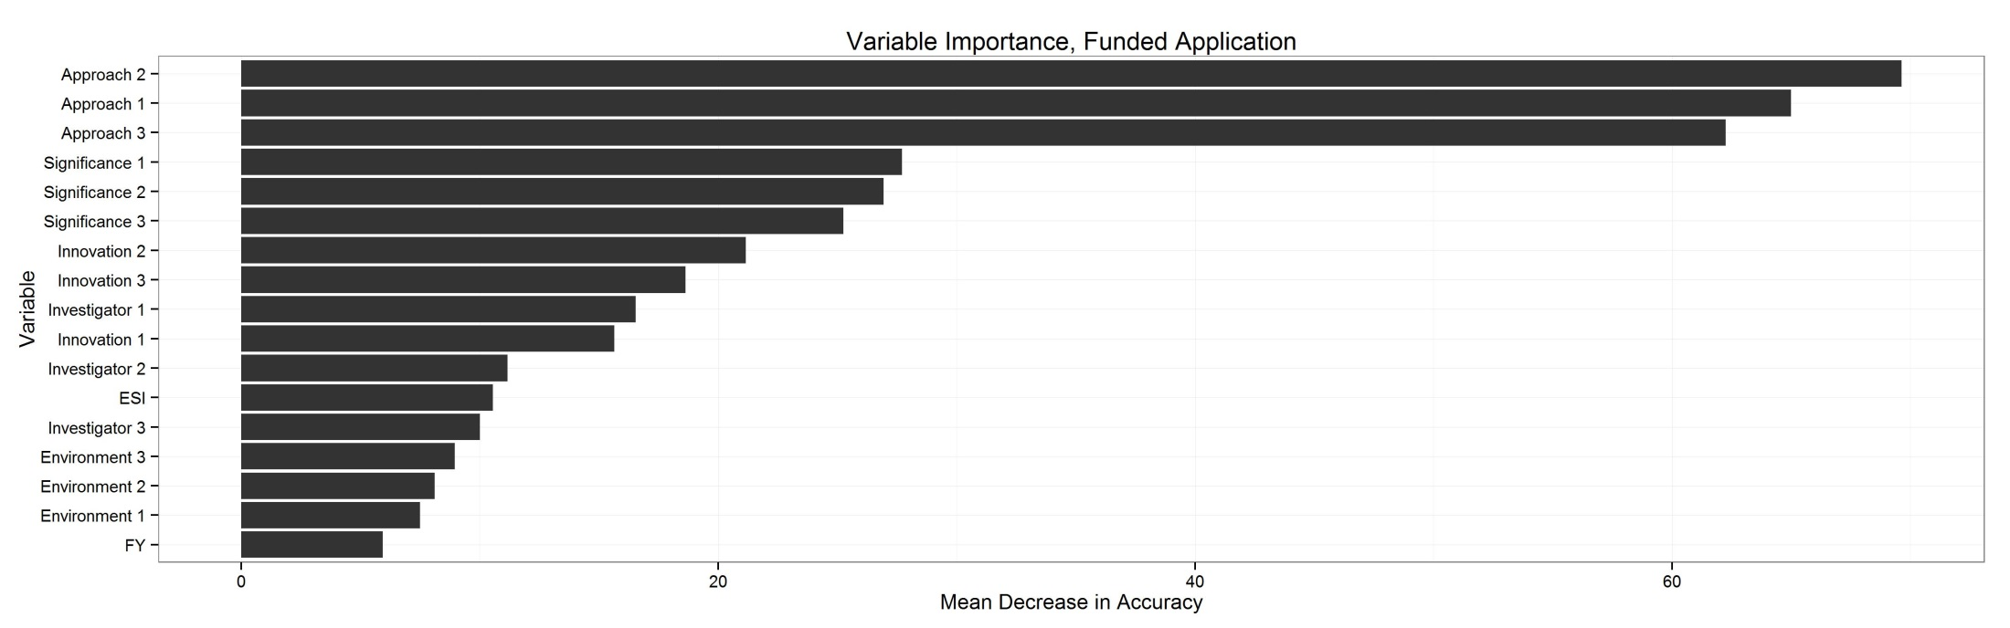
Random Forest
81% Correctly Classified
82% Correctly Classified

Slide 20
Summary
 | Logistic regression | Classification tree | Conditional inference tree | Random forest
Discussed (% Correctly classified) | 62% | 77% | 80% | 81%
Funded (% Correctly classified) | 70% | 79% | 81% | 82%
Approach score of Reviewer 1 is an important predictor of whether an application gets discussed
Approach and Significance scores overall are important predictors of an application being discussed and funded.
Innovation not main driver for funding decisions.

Slide 21
Lessons Learned
Trees get unwieldy
Little control over tree aesthetics
Machine learning gives you answers→ Does not tell you why

